Slide 1

www.kingdomministriesintl.org
www.kingdomministriesintl.org

Slide 2
KINGDOM
WARFARE
Keith Martens, M.Div

Slide 3
The Big Picture
01
Governing Dynamics & Principles of Power
The Kingdom of God
Notes:
“Camelot”

Slide 4
In the beginning God created the heavens and the earth. The earth was empty, a formless mass cloaked in darkness.
next

Slide 5
And the Spirit of God was hovering over its surface. Then God said, "Let there be light," and there was light. And God saw that it was good. Then he separated the light from the darkness.
next
-Genesis 1:1-4
Notes:
Darkness & evil is the default condition until light is introduced

Slide 6
“Now the serpent was more crafty than any of the wild animals the LORD God had made. He said to the woman, “Did God really say, ‘You must not eat from any tree in the garden’?”
next
- Genesis 3:13 cf., Mt. 4:1-11; Jas. 1:13-18

Slide 7
If you do what is right, will you not be accepted? But if you do not do what is right, sin (Akkadian = the demon) crouching at your door; it desires to have you, but you must master it.”
next
(Genesis 4:7 NIV)
NLT = Sin is (the demon) waiting to attack and destroy you, and you must subdue it."

Slide 8
In the beginning the Word already existed. He was with God, and he was God. He was in the beginning with God. He created everything there is. Nothing exists that he didn't make. Life itself was in him, and this life gives light to everyone.
next

Slide 9
The light shines through the darkness, and the darkness can never extinguish it.
next
- John 1:1-5

Slide 10
“We know that we are children of God,
and that the whole world
is under the control of the evil one.”
- 1John 5:19
next

Slide 11
The whole world is a prisoner of sin.
next
- Galatians 4:4

Slide 12
The reason the Son of God appeared was to destroy the devil’s work.
next
- 1 John 3:8

Slide 13
How Jesus Refers to Satan
01
Now is the time for judgment on this world; now the prince of this world will be driven out (John 12.31)
02
I will not say much more to you, for the prince of this world is coming.
He has no hold over me (John 14:30)
03
. . . and about judgment, because the prince of this world now stands condemned (John 16:11)

Slide 14
How NT Writers Characterize Satan
04
The god of this age has blinded the minds of unbelievers, so that they cannot see the light of the gospel that displays the glory of Christ, who is the image of God. (2 Cor. 4:4)
06
We know that we are children of God, and that the whole world is under the control of the evil one (1 John 5:19).
07
“The kingdom of the world has become the kingdom of our Lord and of his Messiah, and he will reign for ever and ever.” (Rev. 11:15)
05
As for you, you were dead in your transgressions and sins, in which you used to live when you followed the ways of this world and of the ruler of the kingdom of the air, the spirit who is now at work in those who are disobedient. All of us also lived among them at one time, gratifying the cravings of our flesh and following its desires and thoughts (Eph. 2:2)
08
They had as king over them the angel of the Abyss, whose name in Hebrew is Abaddon and in Greek is Apollyon (that is, Destroyer). (Rev 9:1)

Slide 15
09
He seized the dragon, that ancient serpent, who is the devil, or Satan, and bound him for a thousand years. He threw him into the Abyss, and locked and sealed it over him, to keep him from deceiving the nations anymore until the thousand years were ended (Rev. 20:3)
10
When the thousand years are over, Satan will be released from his prison and will go out to deceive the nations in the four corners of the earth (Rev 20:8)

Slide 16
Be alert and of sober mind. Your enemy the devil prowls around like a roaring lion looking for someone to devour. Resist him, standing firm in the faith
next
- Peter 5:8-9

Slide 17
The devil led him (Jesus) up to a high place and showed him in an instant all the kingdoms of the world. And he said to him, “I will give you all their authority and splendor; it has been given to me, and I can give it to anyone I want to. If you worship me, it will all be yours.”
next
- Luke 4:5-7

Slide 18
“The thief comes only to steal and kill and destroy;
next
- John 10:10

Slide 19
I have come that they may have life, and have it to the full . . .”
next
- John 10:10

Slide 20

Sources of Evil & Opposition
Ephesians 2:1-3
World - natural/fallen world, world’s system
Flesh - human nature/will and desires
Devil - satanic opposition, powers of this world
next

Slide 21
For our struggle is not against flesh and blood, but against the rulers, against the authorities, against the powers of this dark world and against the spiritual forces of evil in the heavenly realms.
next
- Ephesians 6:12

Slide 22
God’s Warfare Strategy
His intent was that now, through the church, the manifold wisdom of God should be made known to the rulers and authorities in the heavenly realms, according to his eternal purpose which he accomplished in Christ Jesus our Lord.
next
- Ephesians 3:10-11

Slide 23
God’s Provision Through Jesus Christ
I have given you authority . . . to overcome all the power of the enemy; nothing will harm you.
next
- Luke 10:19

Slide 24
You will receive power when the Holy Spirit comes upon you; and you will be my witnesses . . . to the ends of the earth.
next
- Acts 1:8

Slide 25
The weapons we fight with are not the weapons of the world. On the contrary, they have divine power to demolish strongholds.
next
- 2 Corinthians 10:4

Slide 26
Put on the full armor of God, so that you can take your stand against the devil’s schemes. For our struggle is not against flesh and blood, but against the rulers, against the authorities, against the powers of this dark world and against the spiritual forces of evil in the heavenly realms.
next
- Ephesians 6:11-12

Slide 27
In addition to all this, take up the shield of faith, with which you can extinguish all the flaming arrows of the evil one. Take the helmet of salvation and the sword of the Spirit, which is the word of God. And pray in the Spirit on all occasions with all kinds of prayers and requests.
next
- Ephesians 6:17-18

Slide 28
Jesus replied, “Truly I tell you, if you have faith and do not doubt, not only can you do what was done to the fig tree, but also you can say to this mountain, ‘Go, throw yourself into the sea,’ and it will be done. If you believe, you will receive whatever you ask for in prayer.”
next
- Matthew 21:21-22

Slide 29

Spiritual
Emotional
Physical/Physiological
Unresolved/Unconscious Roots

Slide 30
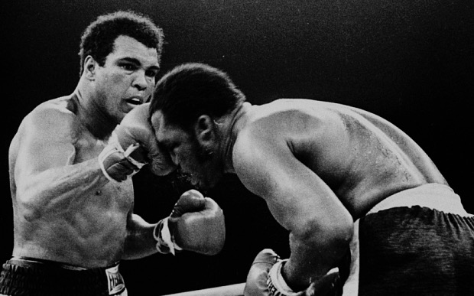
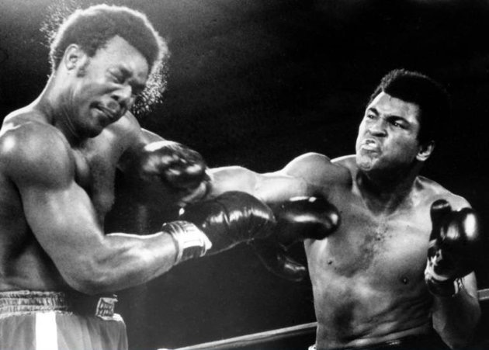
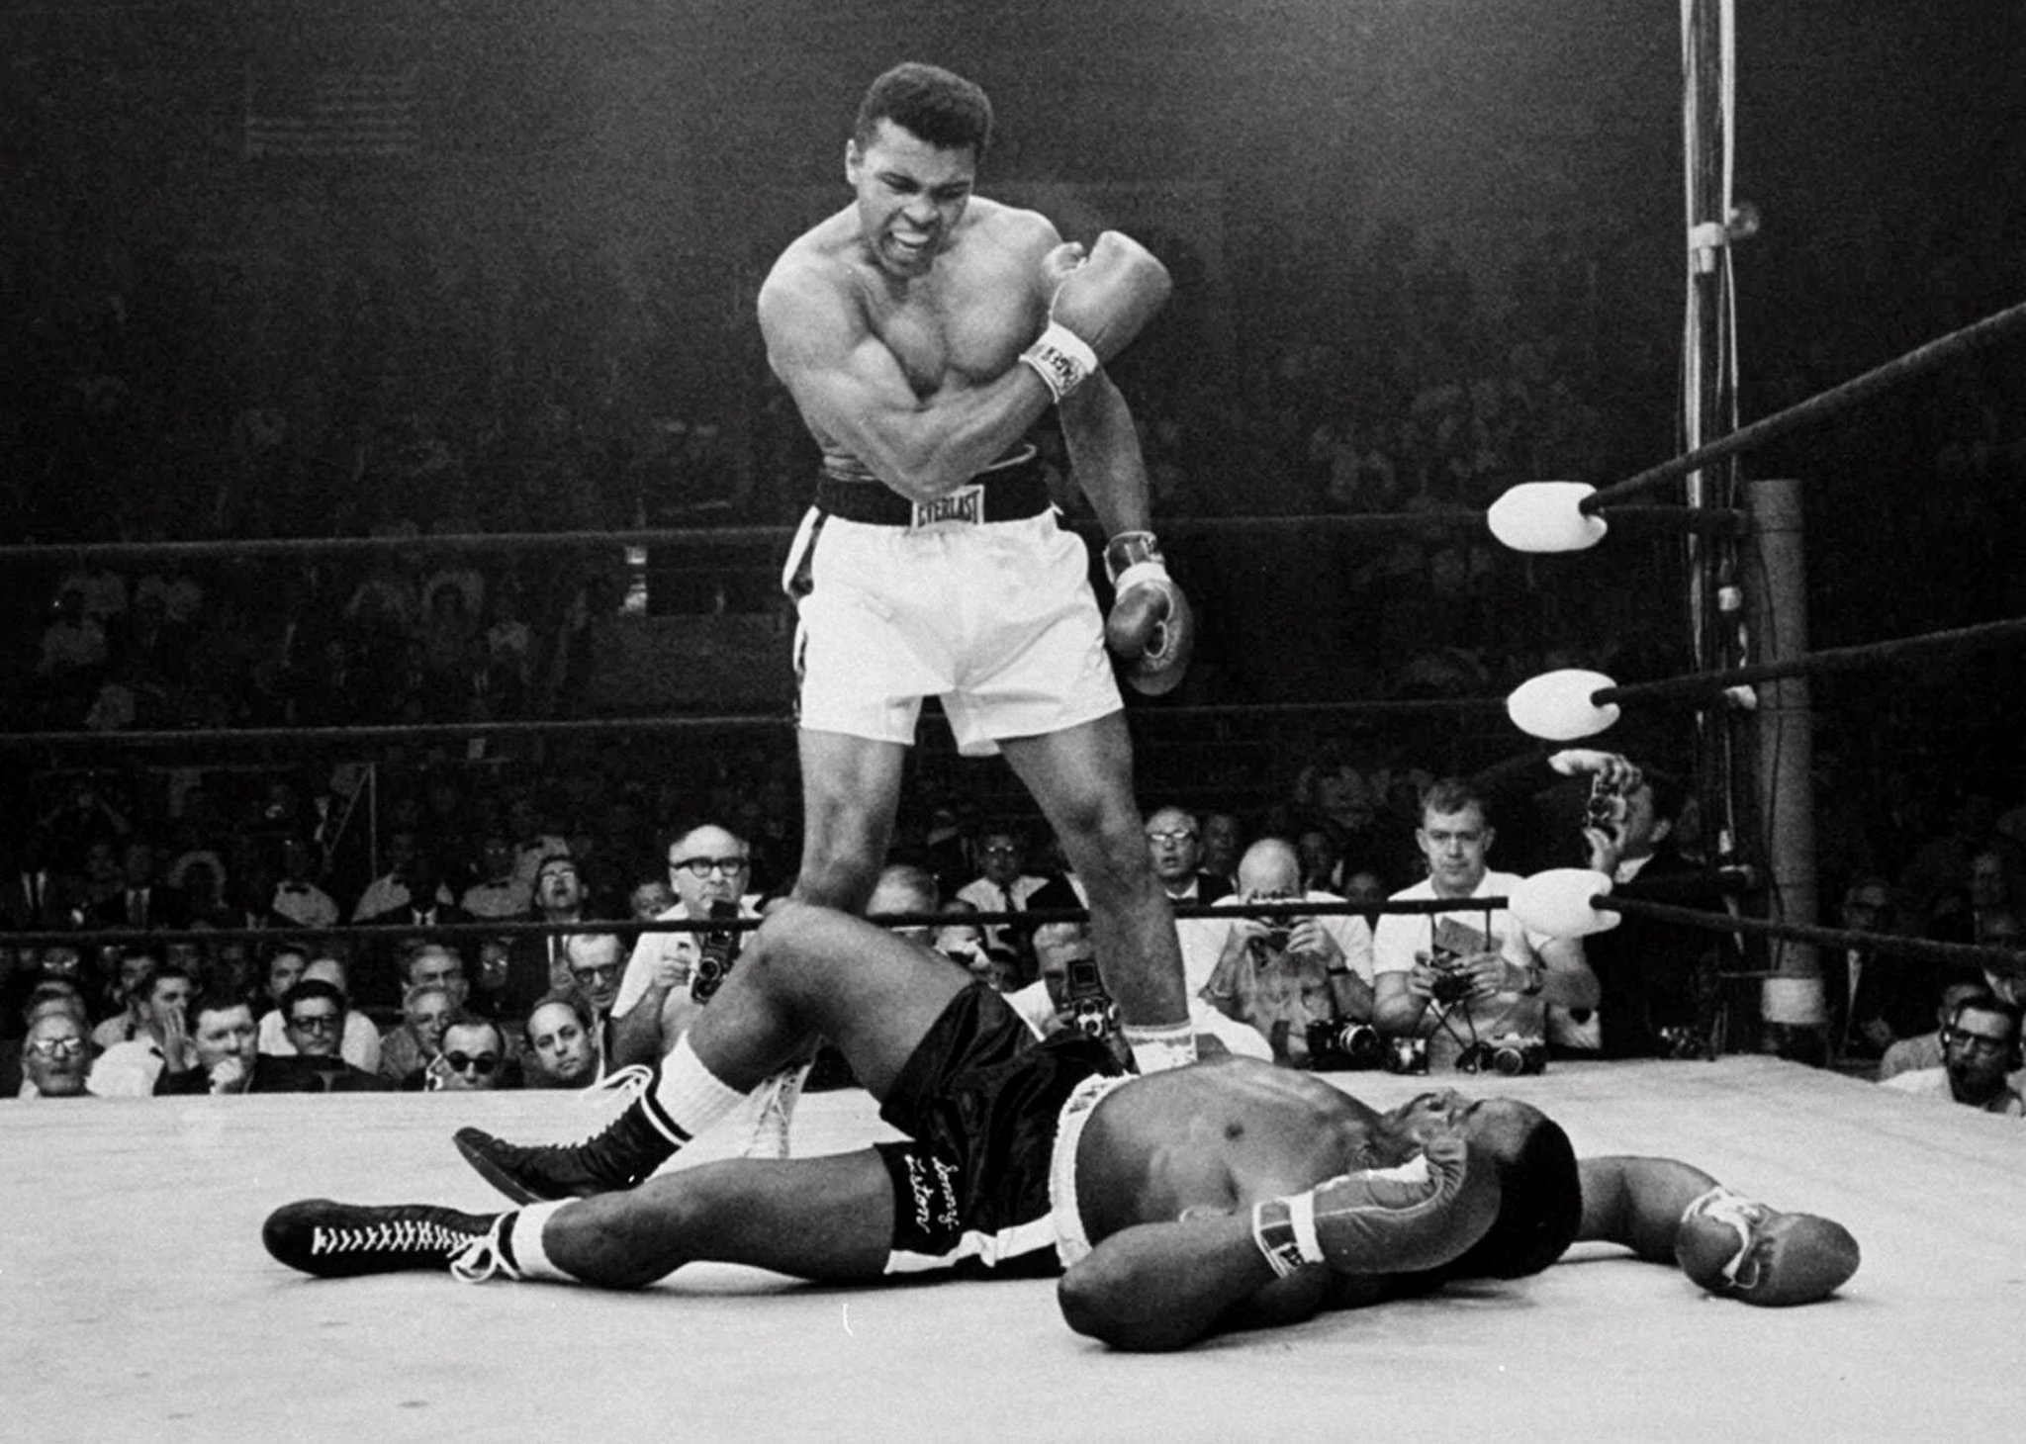
“Therefore I do not run like a man running aimlessly; I do not fight like a man beating the air.”
        - 1 Corinthians 9:26

Slide 31
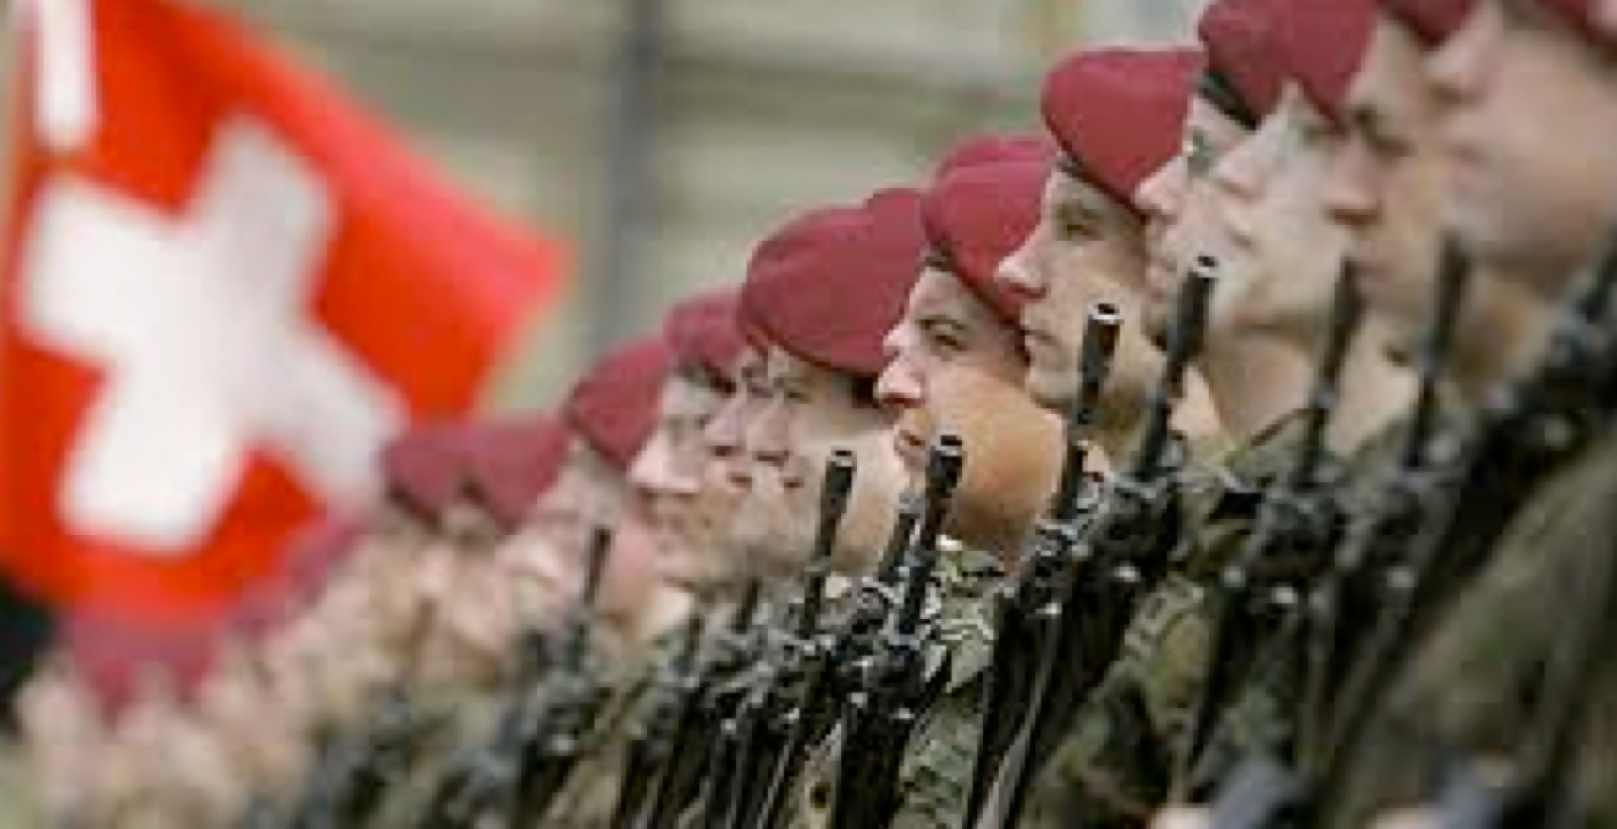
“No one serving as a soldier gets entangled in civilian affairs, but rather tries to please his commanding officer.”
                - 2 Timothy 2:4

Slide 32
The Kingdom of God
The “Good News” or “Gospel” of the Kingdom of God
Notes:
A “good news” or “proclamation”
Camelot analogy, & clip “Might for Right”

Slide 33
the message
“Preach”: ‘The Kingdom of God is at hand’
Heal the Sick
Cast Out Demons

Slide 34
the means
God’s Word
Christ’s Authority
The Holy Spirit’s Counsel

Slide 35
authority
THE RIGHT OR ABILITY CONFERRED UPON YOU TO DO SOMETHING
AUTHORIZATION TO ACT OR USE POWER

Slide 36
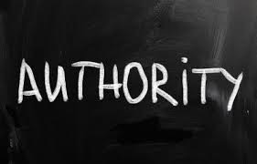
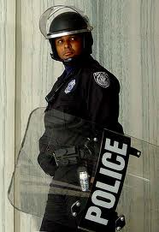
HOW
AUDIBLY
“IN JESUS’ NAME”
DIRECT & FIRST PERSON
WITH SPECIFIC COMMANDS
USING SCRIPTURE
BEGINNING WITH “IF”
IDEALLY WITH 2 OR MORE

Slide 37
WHEN
Proclaiming the Good News of the Kingdom
Healing the sick
Casting out demons
Testing for & resolving spiritual influences
Preventing the influence of evil
Preparing environments
Prayer & Intercession
Barriers & hindrances to God’s will
Protection & covering
Nature/“Storms”
Barriers, hindrances, “mountains”
Testing & discernment

